Slide 1



Introduction
We are a data driven digital advertising firm focus on converting lead & sales via Google ads & Facebook ads. Welcome to our presentation showcasing our client's diverse portfolio of work. We're excited to take you on a visual journey highlighting our few exceptional collaborative efforts.
by Aalok Mallik

Slide 2


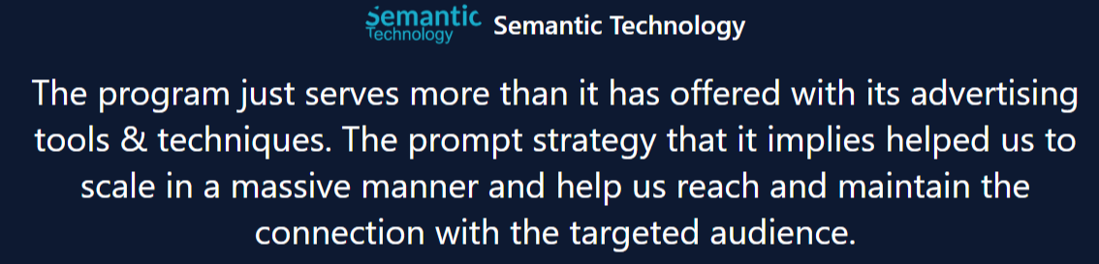
Our Client Portfolio
Diverse Clients
Successful Collaborations
Satisfied Clients
We've had the privilege of working with a wide range of clients across various industries, from startups to established enterprises.
Our tailored solutions have helped our clients achieve their goals and elevate their online presence through exceptional web design and development.
We take pride in the positive feedback and strong relationships we've built with our clients, who continue to trust us with their digital needs.

Slide 3

Client 1: The Authentic Nepal
Target Market: USA
Ad spend:$5000/mo
ROAS:5x
This domain sells Buddha statues & singing bowls in US market. Objective was to lower down CAC & increase ROAS.
We ran ads on Google shopping Network with feed only performance max for prospecting & remarketing campaign with pmax all assets.
In terms of achieving ROAS of 5x we segmented out 2 categories i.e. singing bowls & statues for pmax feed only campaign.

Slide 4
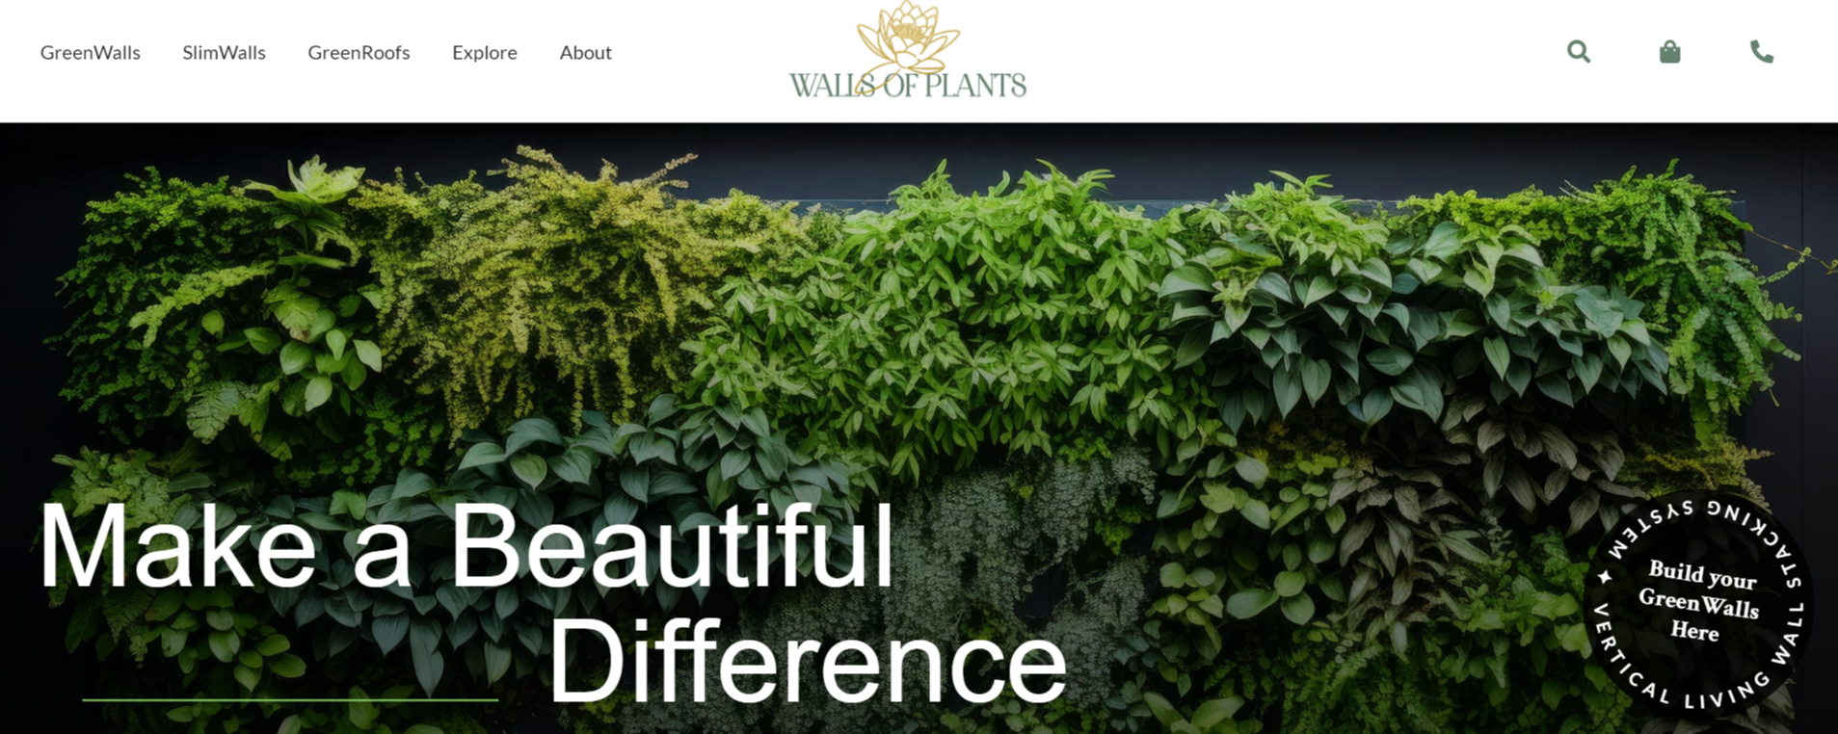
Client 2: Walls of plants
Target Market: UK
Ad spend:$3000/mo
ROAS:5x
Campaign object was to sell living plant walls kit online and also bring valid leads of people who want to install living walls on their premises.
Since the business is of D2C in nature so we have to run 2 campaign i.e. Search ads + Shop. Ads + P.max Feed only ads which escalated sales/Leads
5X ROAS was generated by impact of shopping ads running in between which pushed P.max campaign to perform tremendously. New Cust increase by 20% MOM

Slide 5

Client 3: Enabling community
Target Market: Austr.
Adspend:$7000/mo
ROAS:4x
Campaign objective was to bring down leads of people who needs personal care & domestic care services in Australia
We ran search ads with broad match keywords + maximize conversion bidding strategy TCPA + YT remarketing campaign.
For 4x we put all audience into observation made while running search ads and had insights of audience performing well & thus we pushed ads on YT after that

Slide 6
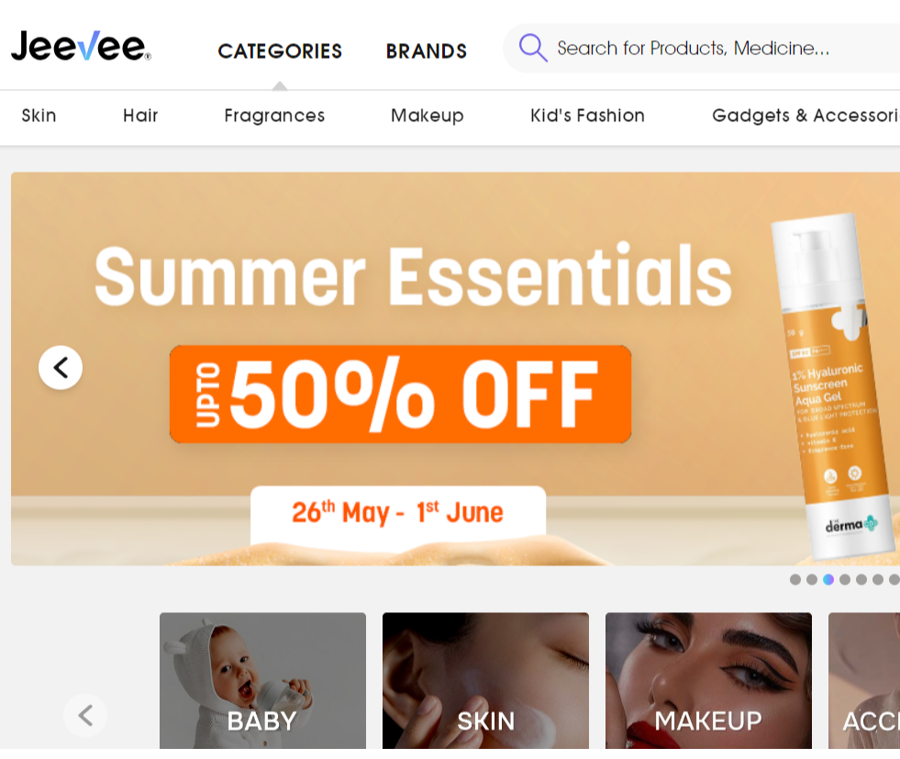
Client 4:Jeevee
Target Market: Nepal
Ad Spend: $15000/mo
Campaign objective was to increase ROAS on 7 categories and increase new customers by 30% by lowering down CAC.
We ran DSA ads for 7 categories + Pmax feed only camp. For prospecting and then remarketed them on Youtube with TCPA. We also ran Facebook DPA catalog ads for remarketing.
ROAS: 8x
On mega campaign days we achieve even more than 8x through this strategy on normal days it reduce to 5x + App install campaign was also there for new customer acquisition.

Slide 7
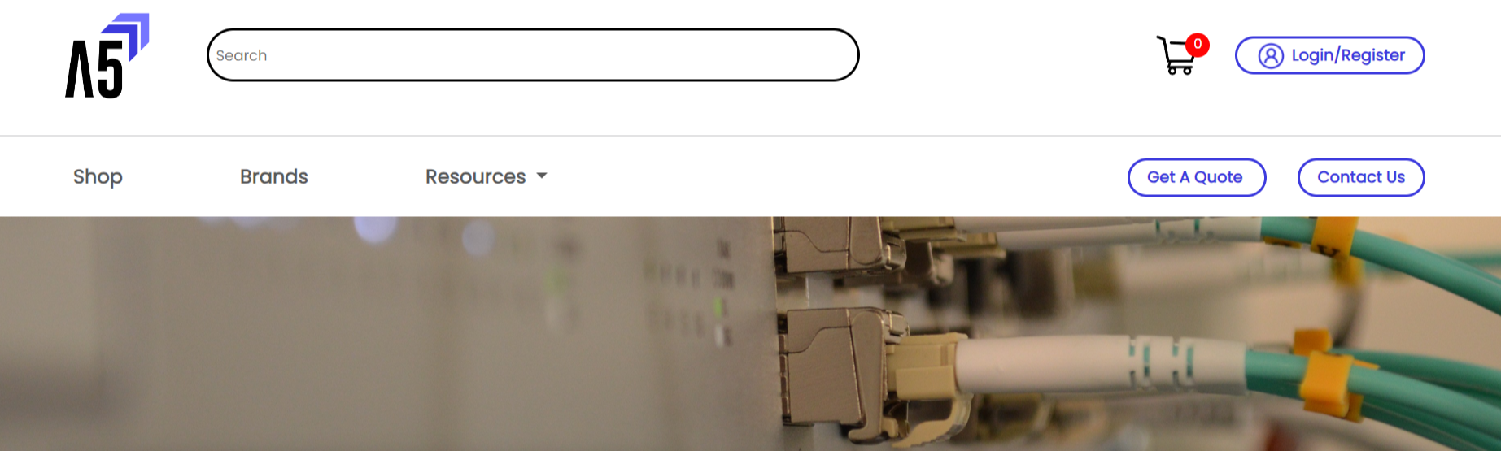
Client 5:A5it.com
Target Market: USA
Ad Spend : $4000/mo
ROAS:6x
Campaign objective was to increase profit for business with limited products like: meraki license. We were also supposed to acquire new customer and run hubspot email marketing for upselling other products.
We ran Pmax feed only + shopping ads campaign for prospecting and Pmax all assets for remarketing + YT dynamic remarketing each and every month to increase profit by 30% MOM
For ROAS OF 6X we filtered high margin products as per each and every categories.

Slide 8

Testimonials
Our clients have expressed tremendous satisfaction with our digital ads services. They praise our attention to detail, creativity, and ability to bring their visions to life.
"Working with this team was an absolute pleasure. They listened to our needs and delivered a ROAS & CAC that exceeds our expectations.“- Walls of Plants

Slide 9

Contact Us
Get in touch with our talented team to discuss your next web design project. We're ready to bring your vision to life.
Email: contact@byaakdigital.com
Book an Appointment: https://calendly.com/byaakdigital/clientappointment

